Slide 1
T1International
Reproducing analysis of the 2020 survey with 2022 data
Axel Thieffry November 2022

Slide 2
Content
Country distribution and top 7 selection
Healthcare coverage
Out-of-Pocket Expenses (OoPEs) - by expense category - by healthcare coverage type - by country (top 7) - full breakdown
COVID-19 impact
Rationing - by healthcare coverage type - by country income level - in top 7 most represented countries
Demographic table

Slide 3
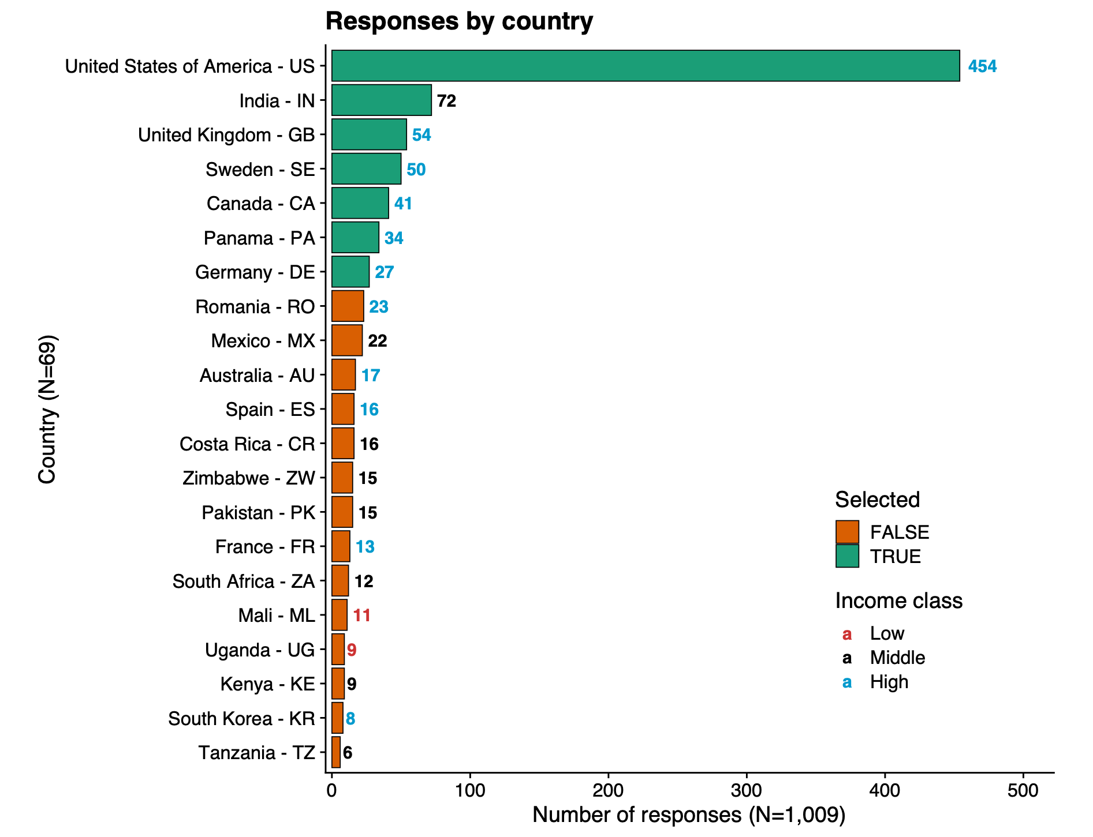
Country & healthcare coverage
Updated Feb. 2023 ✅
The “Top 7”
7 countries with 25+ respondents: US, IN, GB, SE, CA, PA, DE (same threshold as for the 2020’s survey analysis)
US, CA, GB also in 2020’s survey analysis: potential for comparison
Responses from other countries not considered further as not representative (threshold of 25 already being a stretch)
All top 7 countries are high-income except India (IN), which is middle-income

Slide 4
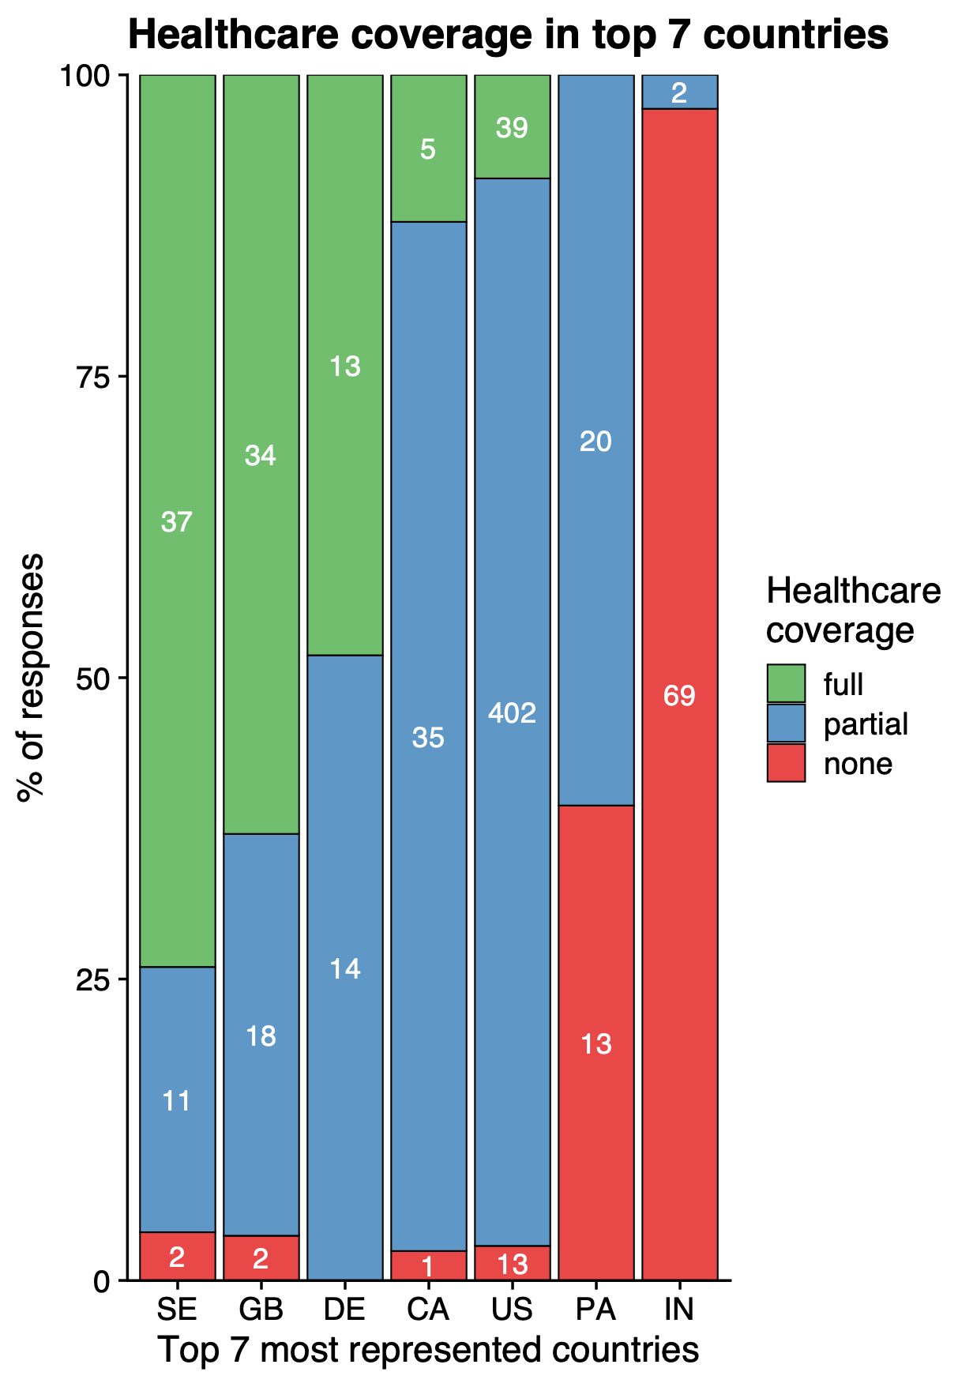
Healthcare coverage in Top 7
Updated Feb. 2023 ✅
Most combinations are present: - majority of full (SE, GB) - balance full/partial (DE) - majority partial (CA, US) - balance partial/none (PA) - majority none (IN)
Potential danger for publication: Nb. of responses for these sub-categories are really low
Order from left-to-right according to full, then none

Slide 5
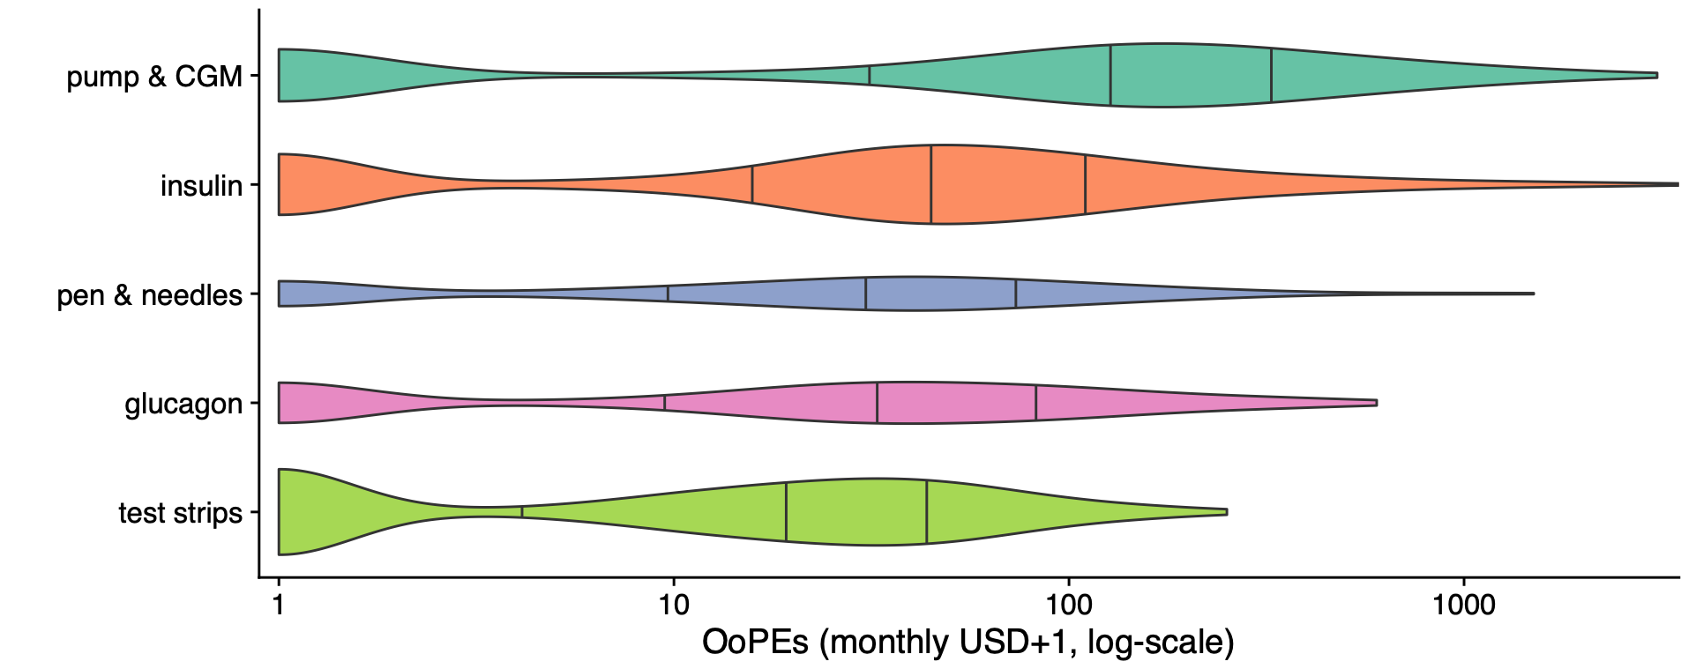
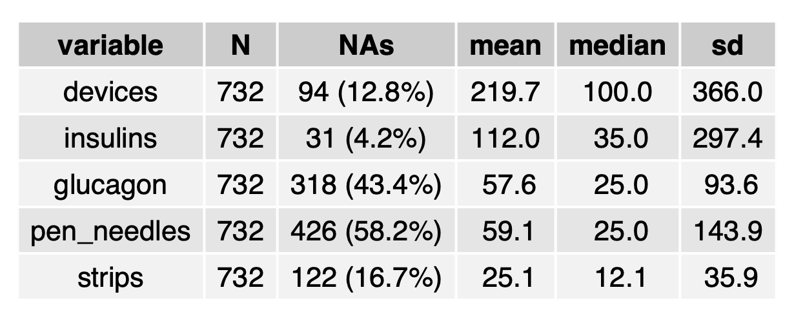
Out-of-Pocket Expenses
Updated Feb. 2023 ✅
Per expense category
Definitions: - pump & CGM: pump supplies + CGM - Insulin: short-, long-, mixed-, other-acting insulins - Pen & needles - Glucagon - Strips: BG strips (not ketone)
Graph reading: - violin areas are proportional to the number of answers - vertical ticks are 25%, 50% (median), and 75% quantiles - log-scaled with USD pseudocount of 1 to keep 0 USD

Slide 6
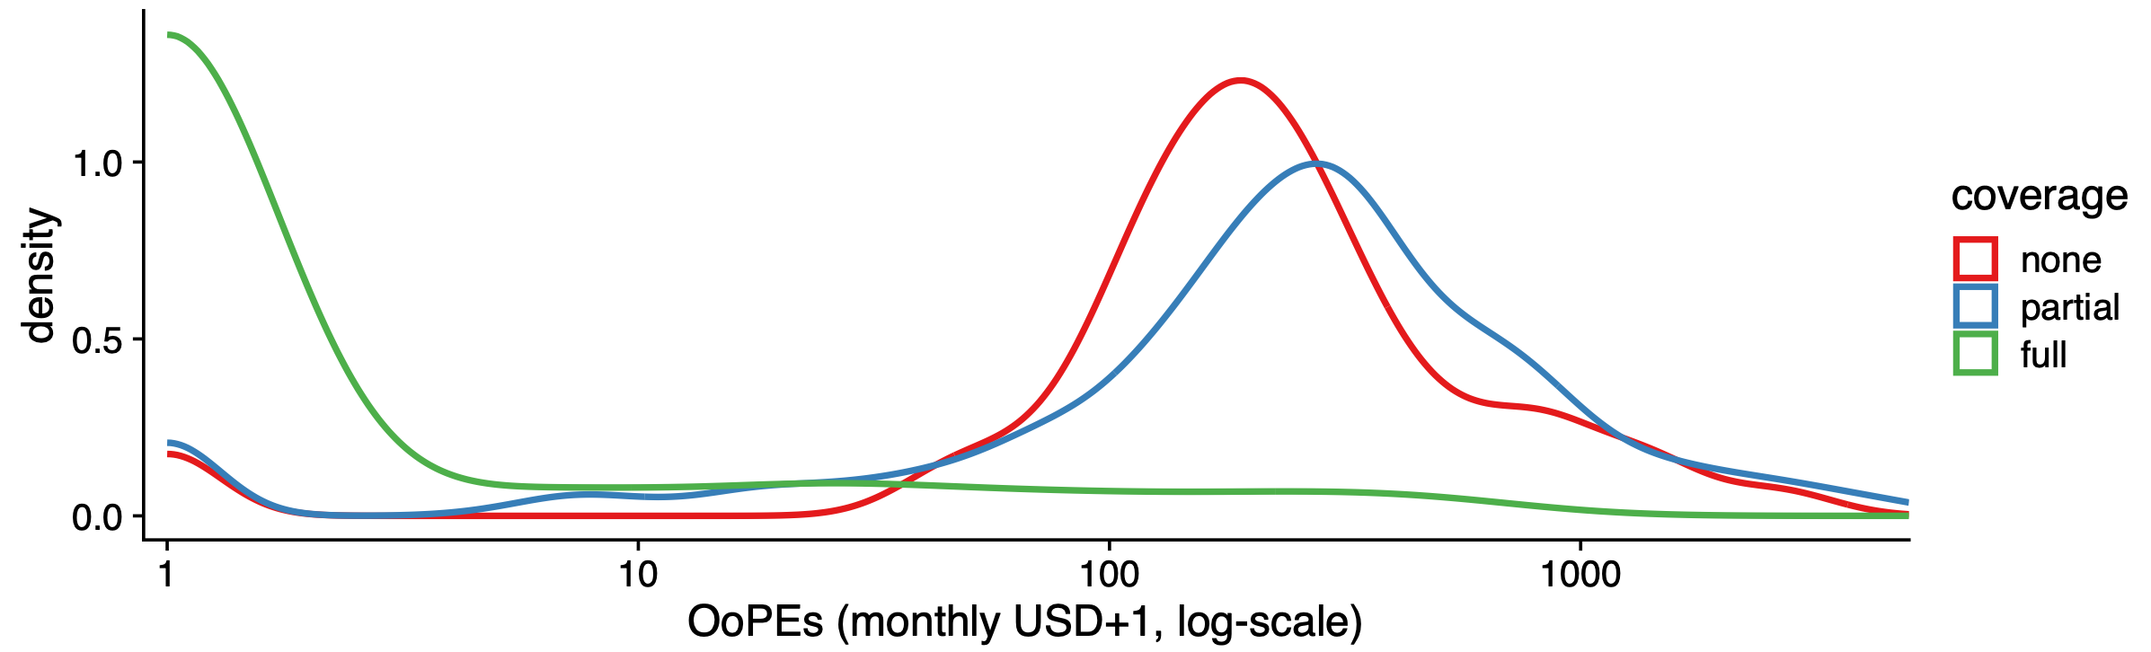
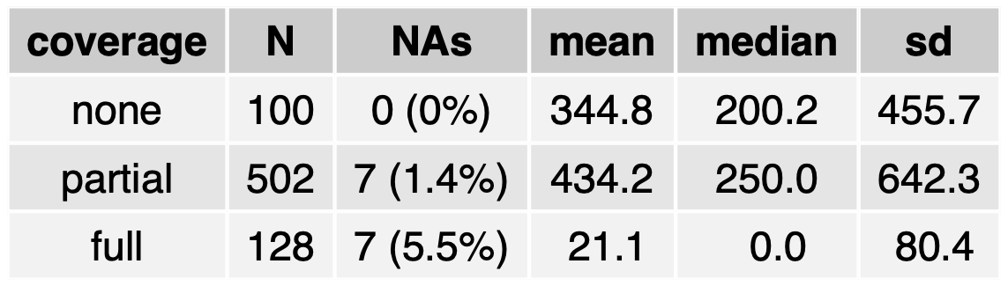
Out-of-Pocket Expenses
Updated Feb. 2023 ✅ => Glucagon removed from costs
Per healthcare coverage
Sum of monthly expenses (pump & CGM + insulin + pen & needles + BG test strips)
Most full coverage have no OoPE (or very low, e.g. 10-100)
Those with no coverage (median 200, mean 344) have lower OoPEs than those with partial coverage (median 250, mean 434) Cannot really explain it. Perhaps one tend to spend more on diabetes management when subject to some healthcare coverage?

Slide 7
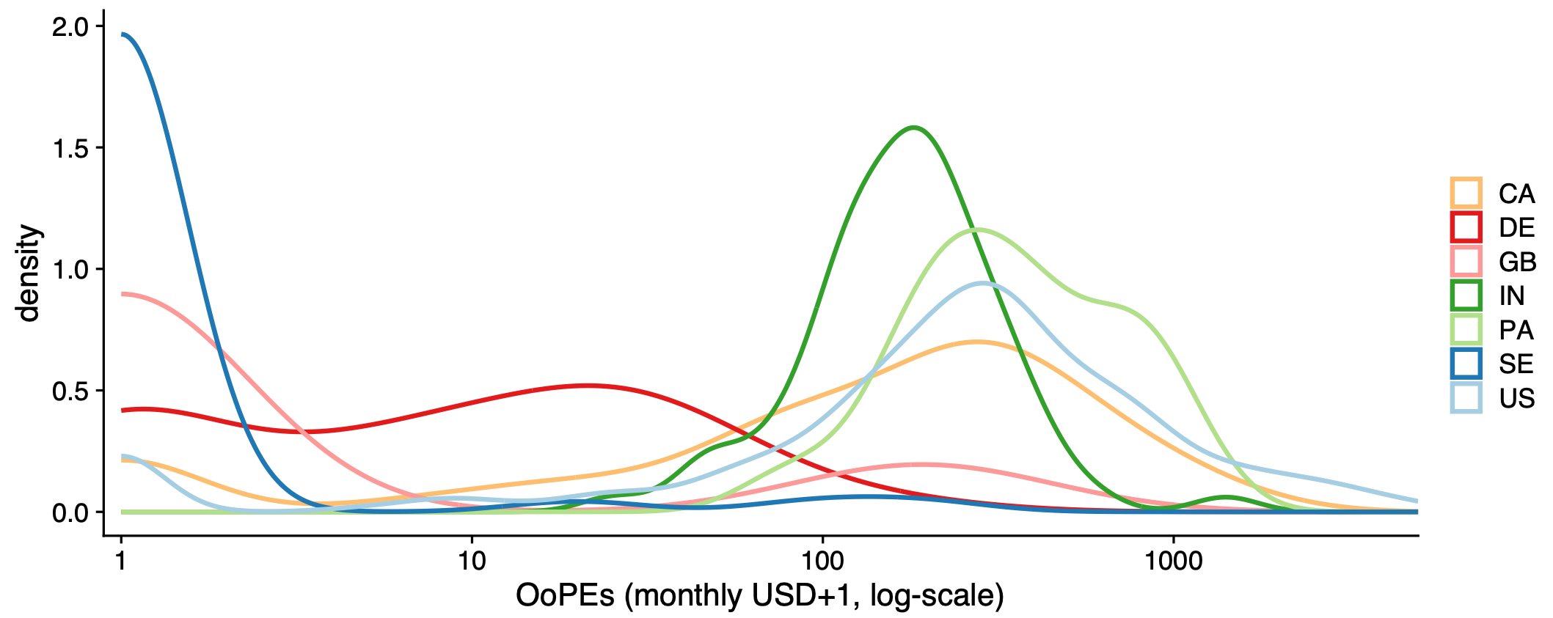
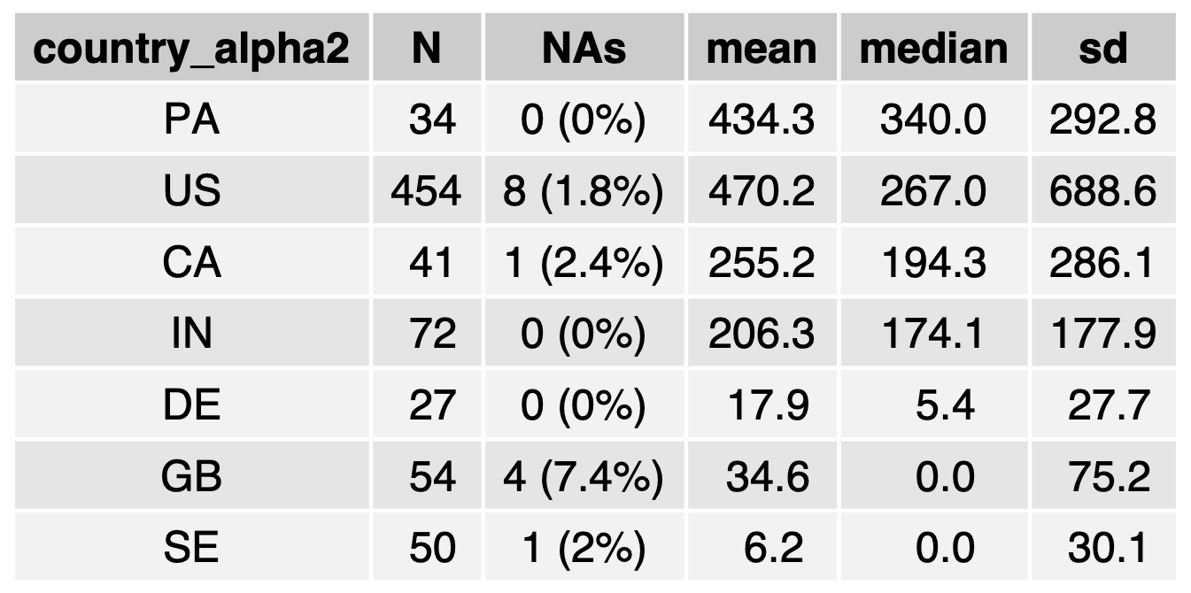
Out-of-Pocket Expenses
Updated Feb. 2023 ✅ => Glucagon removed from costs
Per country (Top 7)
SE
IN
Overall 3 OoPE clusters: - very low: SE, GB - middle: DE - high: IN, US, CA, PA
Usual suspects at the usual places: - EU countries do very well - India not as bad as US - Canada is disappointing
Danger: - India does better than US might be deceiving, bias towards middle-class Indian people? I did expect very bad results for IN.
PA
US
GB
DE
CA

Slide 8
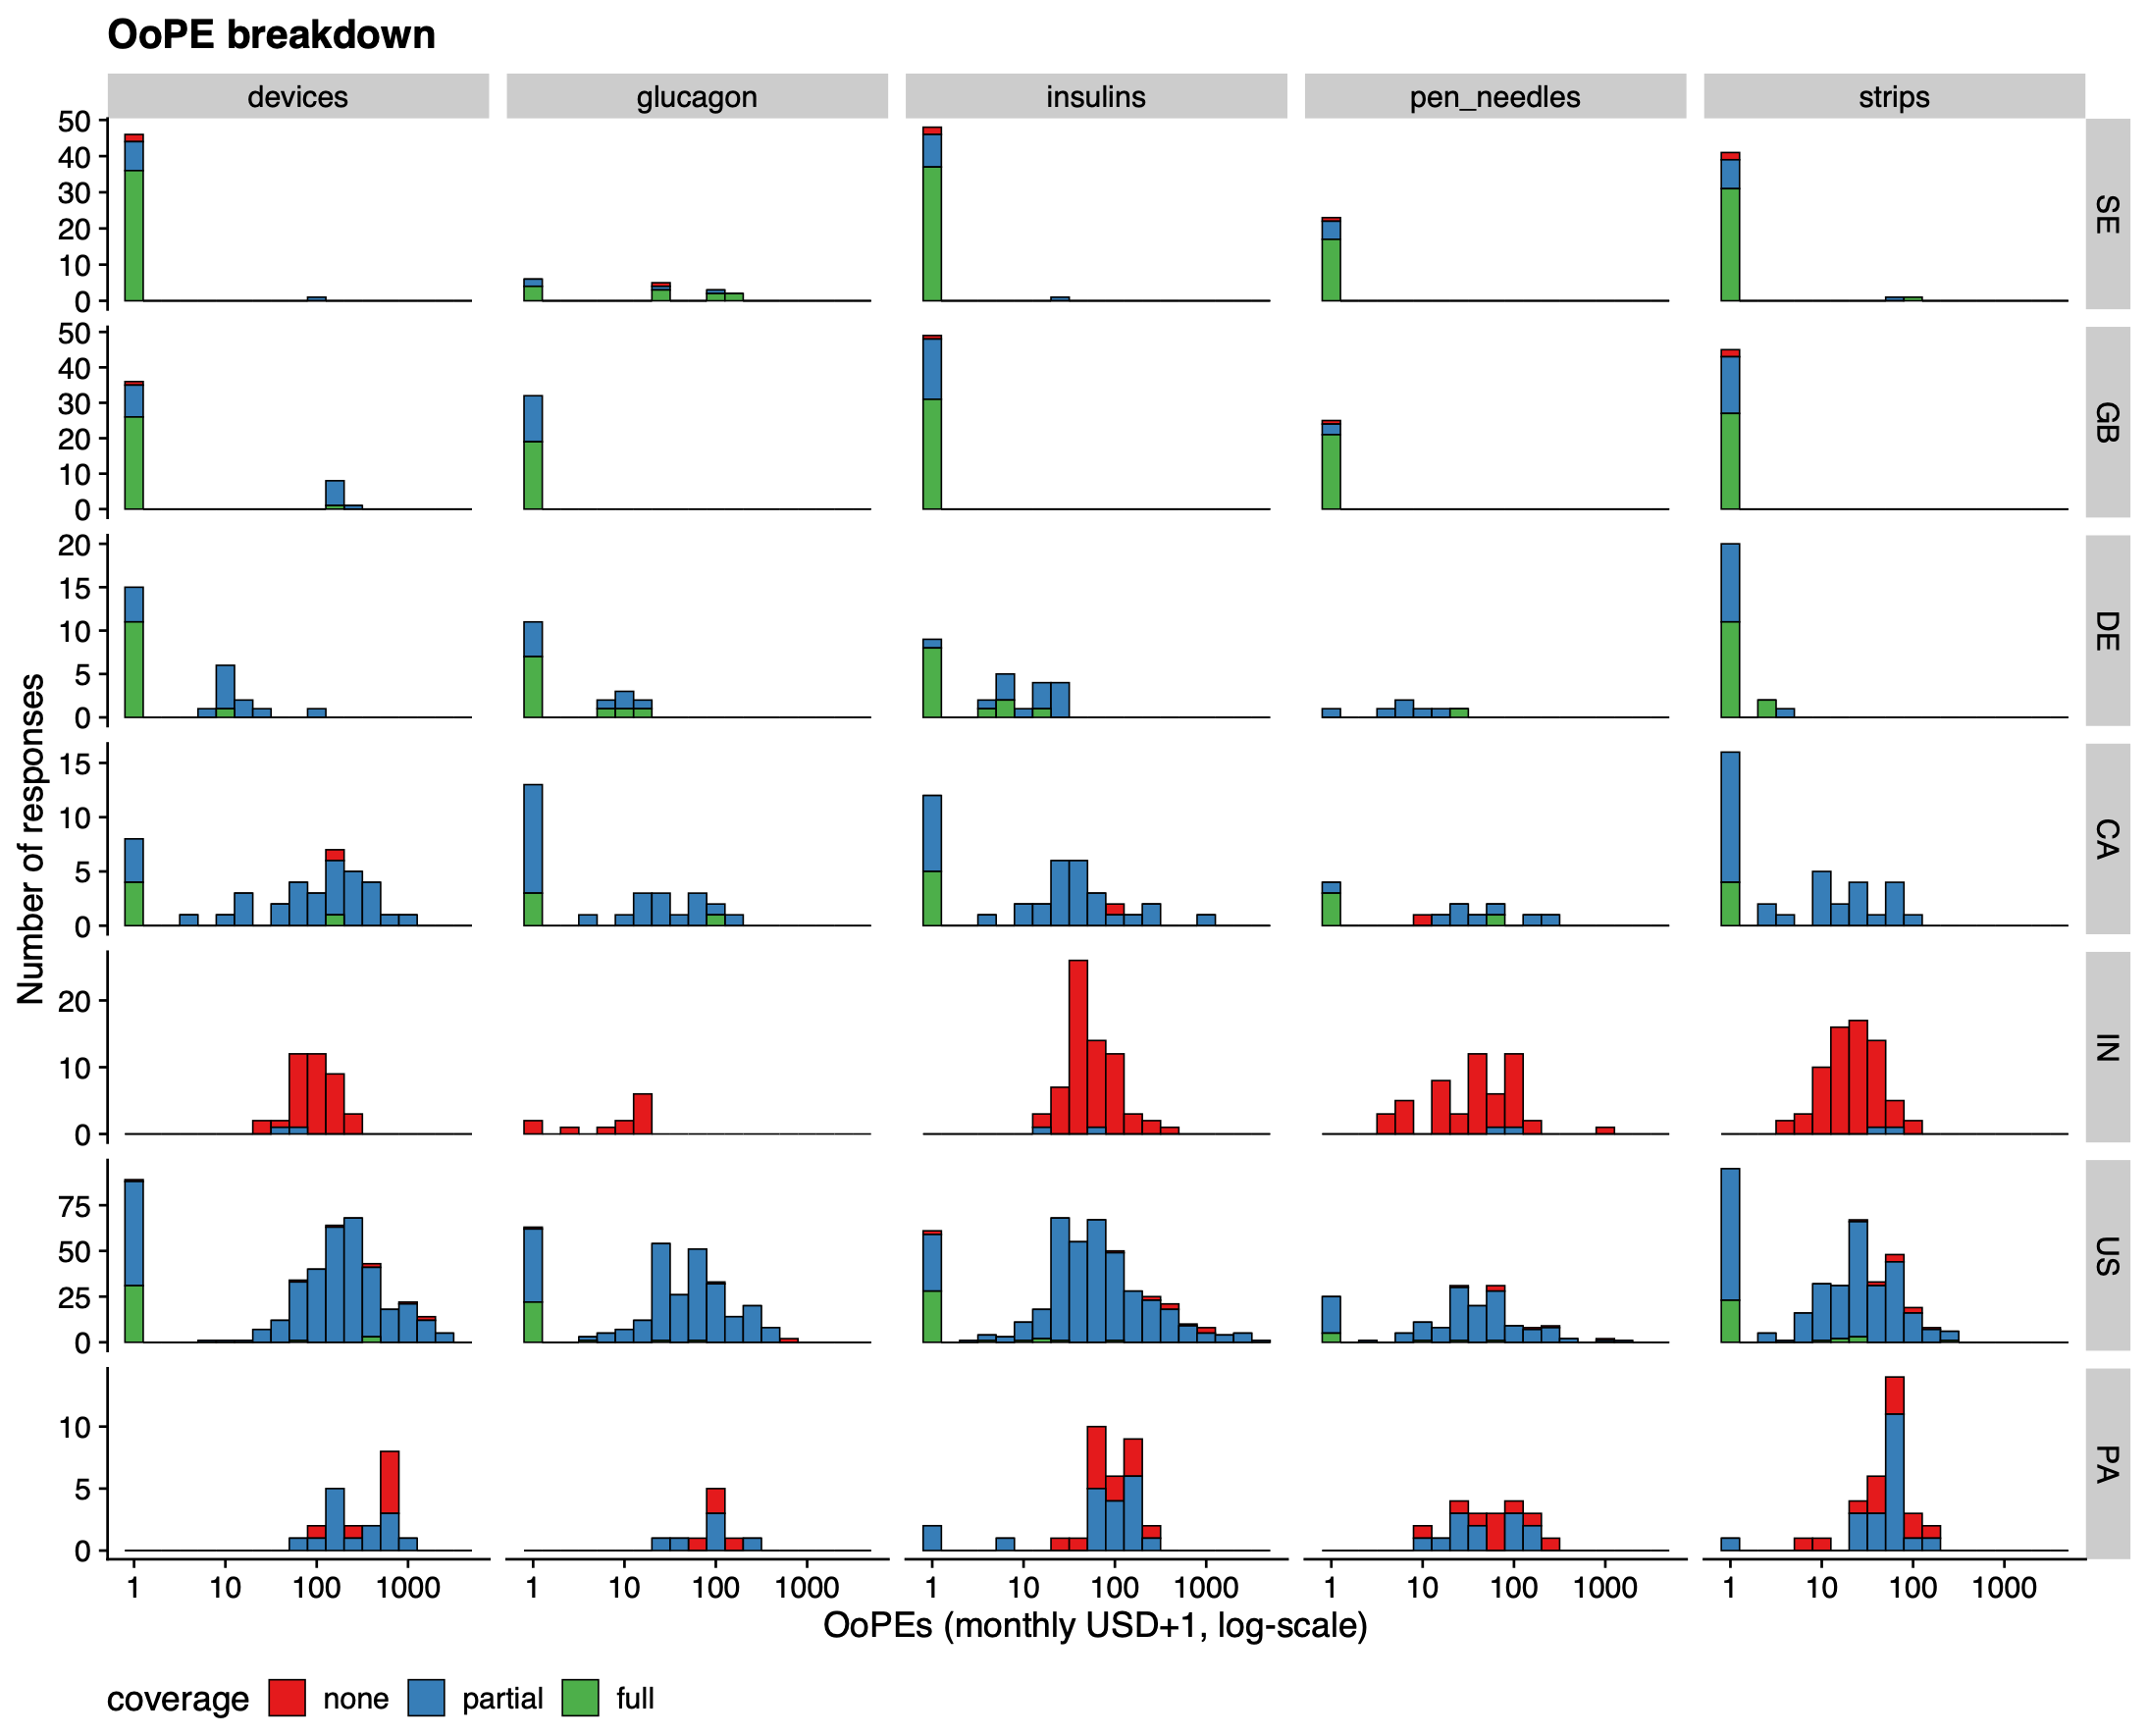
Out-of-Pocket Expenses
Updated Feb. 2023 ✅
Breakdown
(kit price)
Clear difference between EU countries (top 3) and the rest
As expected, immense majority of full coverage have very low OoPEs (very left of the X-axis)
Virtually nobody has no OoPEs in IN & PA
Though virtually no respondent from IN had any healthcare coverage, their OoPEs levels appear similar to people with partial healthcare coverage in the US.

Slide 9


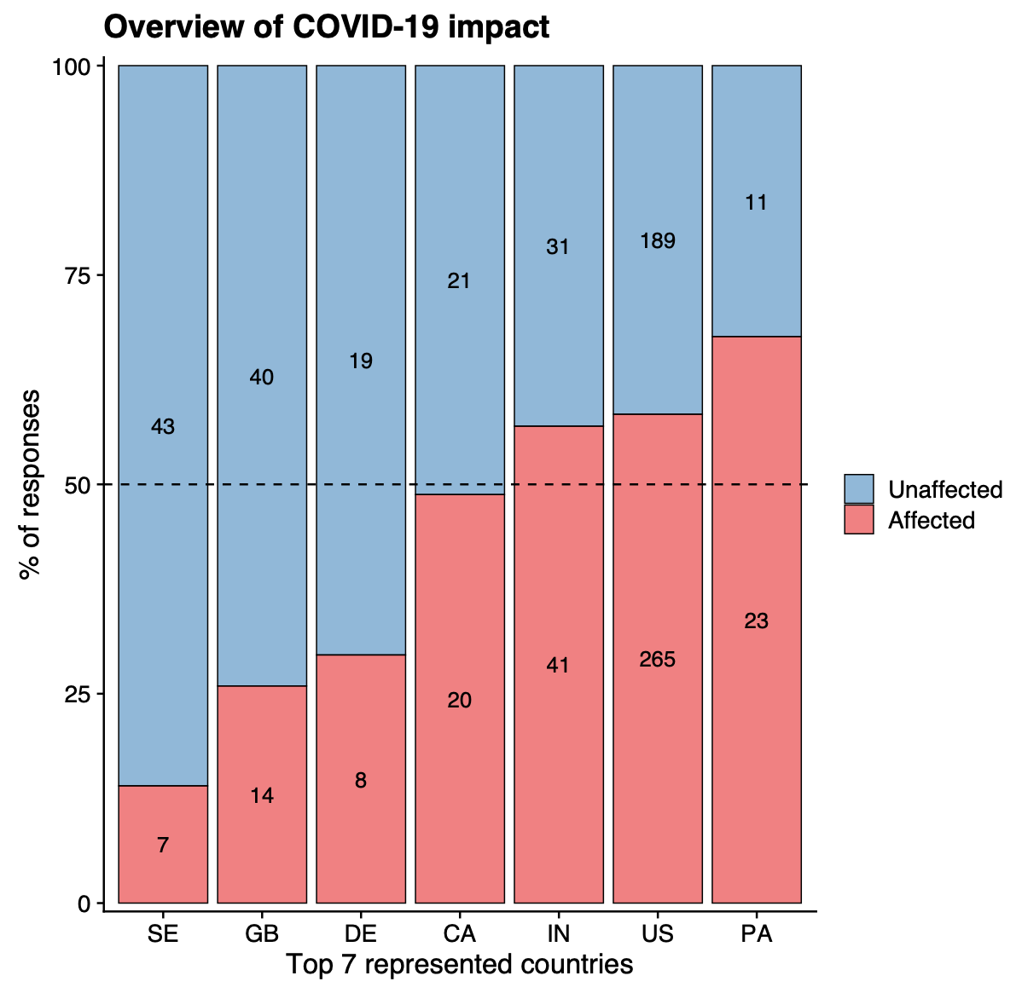
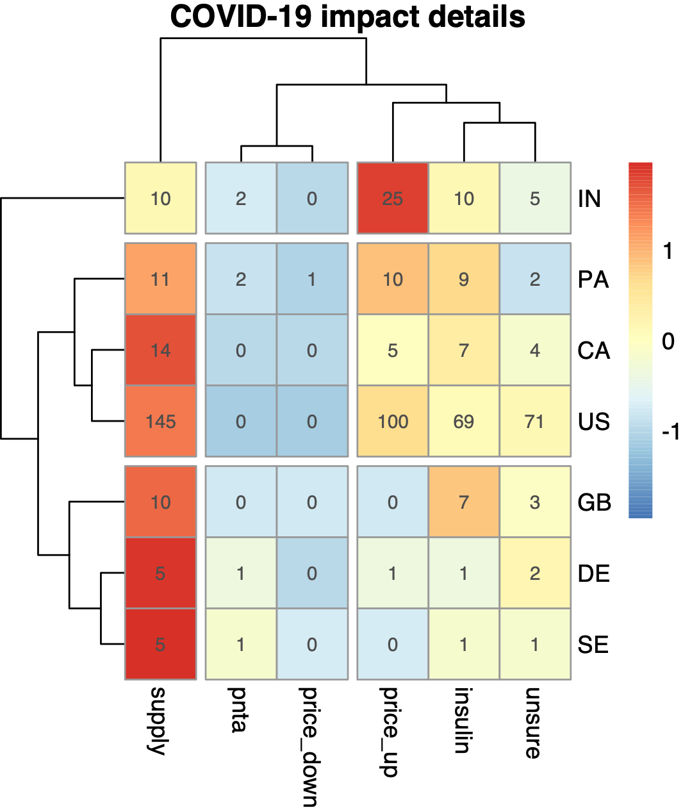



COVID-19 impact
Updated Feb. 2023 ✅
Overview and details
Clustering tree: Allows to group categories together and discern groups by i) country and by ii) impact level
most impacted
least impacted
mildly impacted
Asia group
Color scale: Number of respondents indicating the corresponding COVID-related impact. Color is within each country (i.e. row-wise), allowing to emphasise the most and least impacted categories (red and blue, respectively).
N. America group
Note: Respondents could chose more than one category, so row-sums can be different than the number of respondents from a country (ex: GB)
EU group
Data-driven clustering separates countries by region (EU, N&C Americas, Asia)
Largest impact was on supply, except for IN where it was insulin price surge. Expectedly barely any insulin price lowering.
EU countries were less impacted

Slide 10
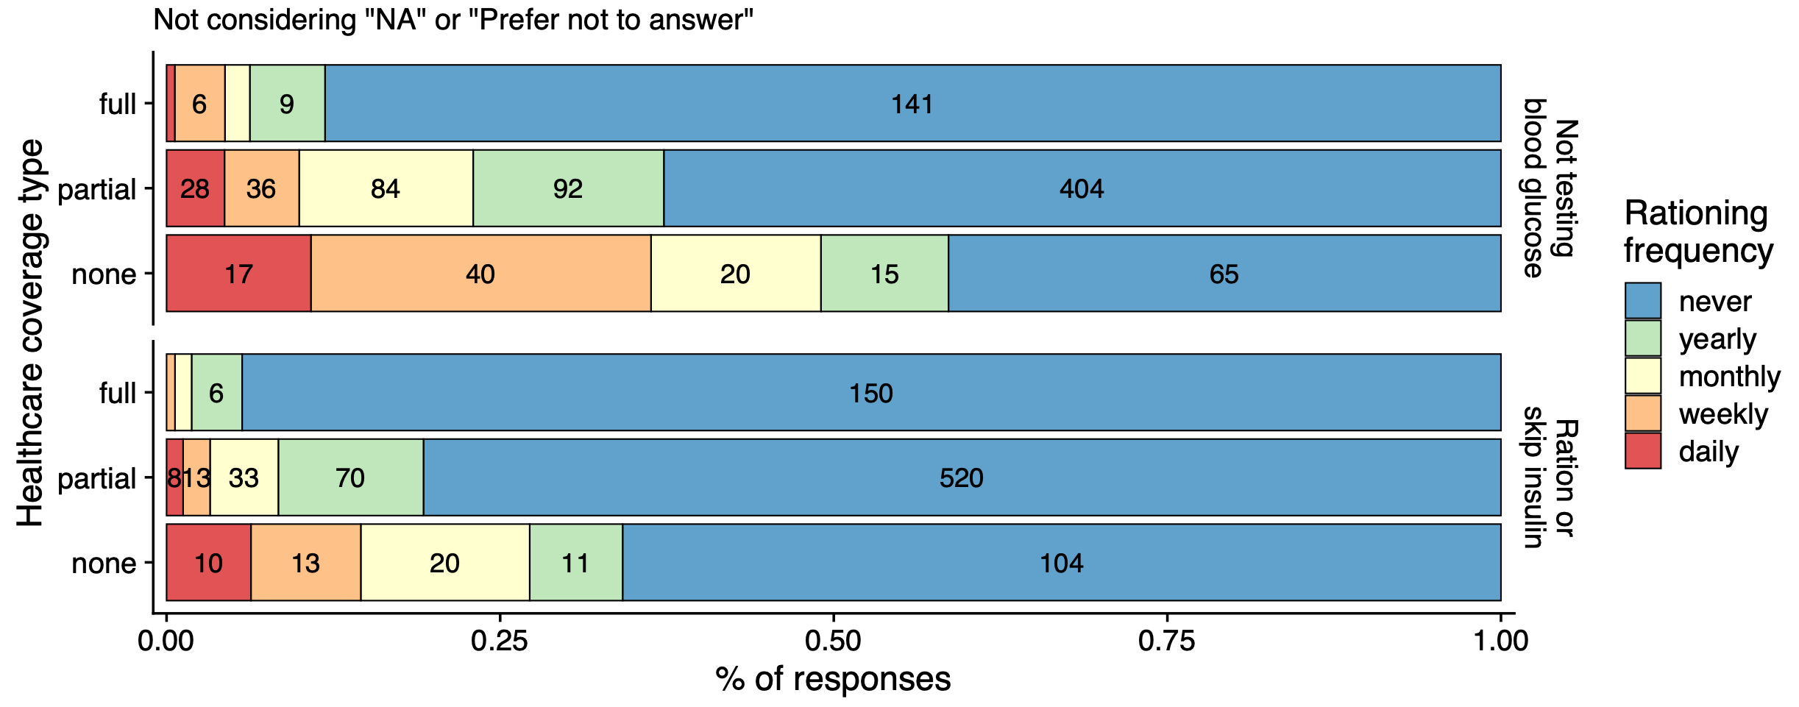
Rationing
Updated Feb. 2023 ✅
By healthcare coverage
Clear negative correlation between the level of healthcare coverage and rationing frequency, both for blood glucose testing and insulin intake.
Overall, testing of blood glucose level is more prone to rationing than insulin intake.

Slide 11
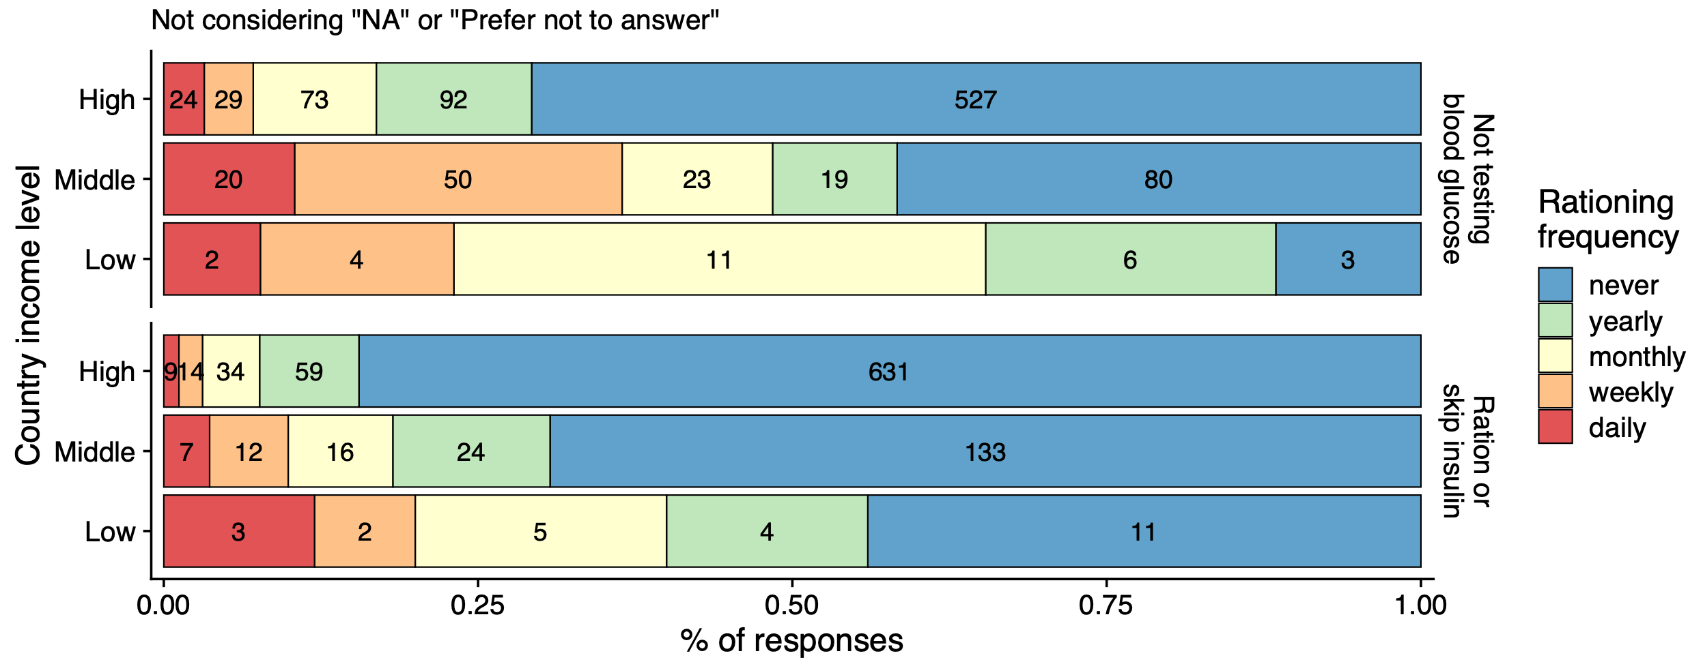
Rationing
Updated Feb. 2023 ✅
By country income level
Clear negative correlation between the country income level and rationing frequency, both for blood glucose testing and insulin intake.
Overall, testing of blood glucose level is more prone to rationing than insulin intake.

Slide 12
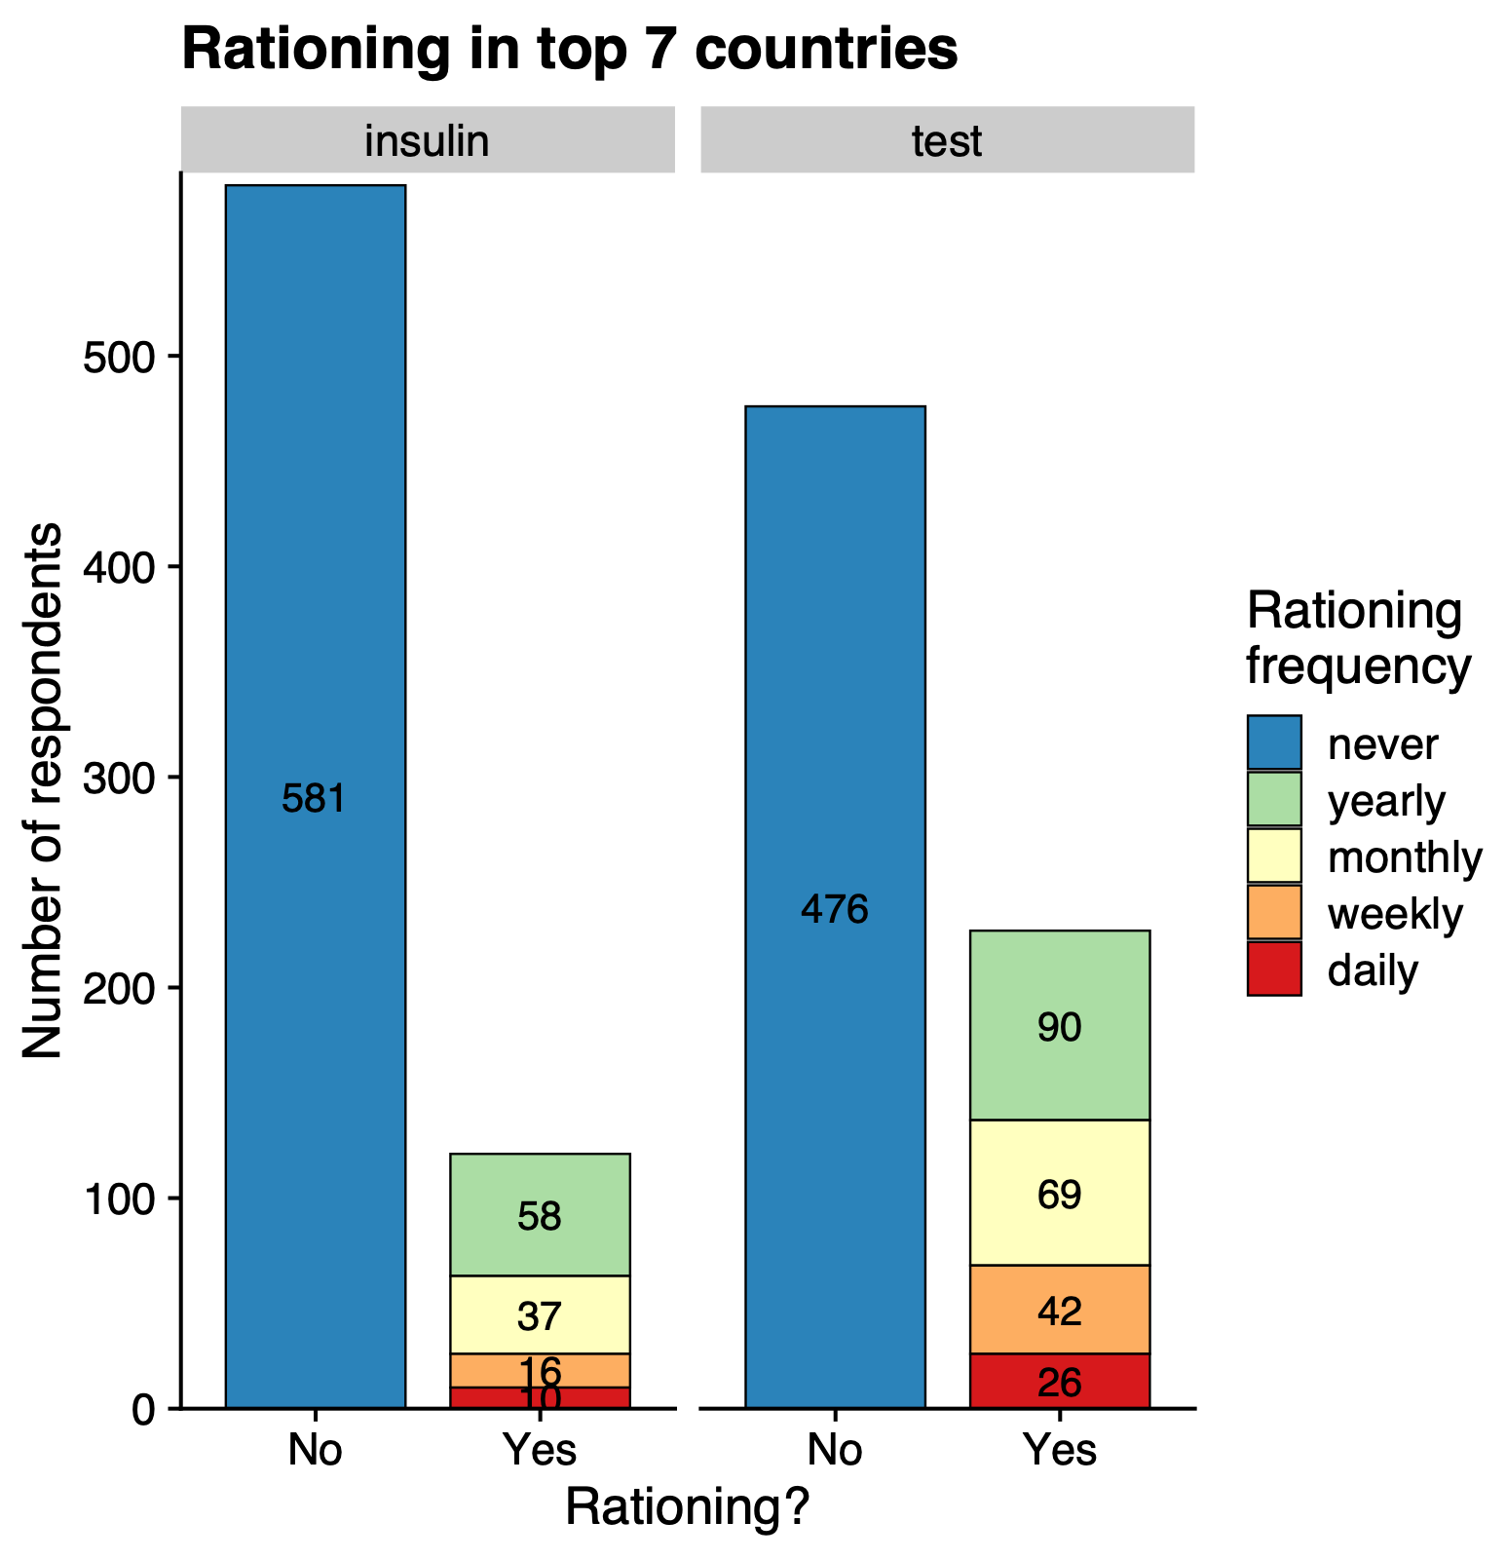
Rationing
NEW Feb. 2023 ✅
In Top 7 most represented countries - aggregated
Aggregated numbers for all respondents from the top 7 countries
Rationing of BG testing is more prevalent than rationing of insulin intake (as saw previously)

Slide 13
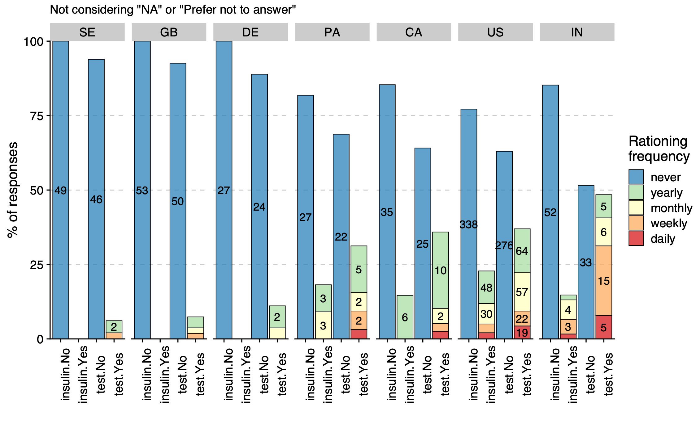
Rationing
Updated Feb. 2023 ✅
In Top 7 most represented countries - detailed
Again clear distinction between EU-countries and the rest, with virtually no rationing/underuse in SE, GB, and DE.
Though with very different country income level and healthcare coverage distributions, IN and US have similar underuse frequencies and are the worst amongst the top 7 most represented countries.

Slide 14
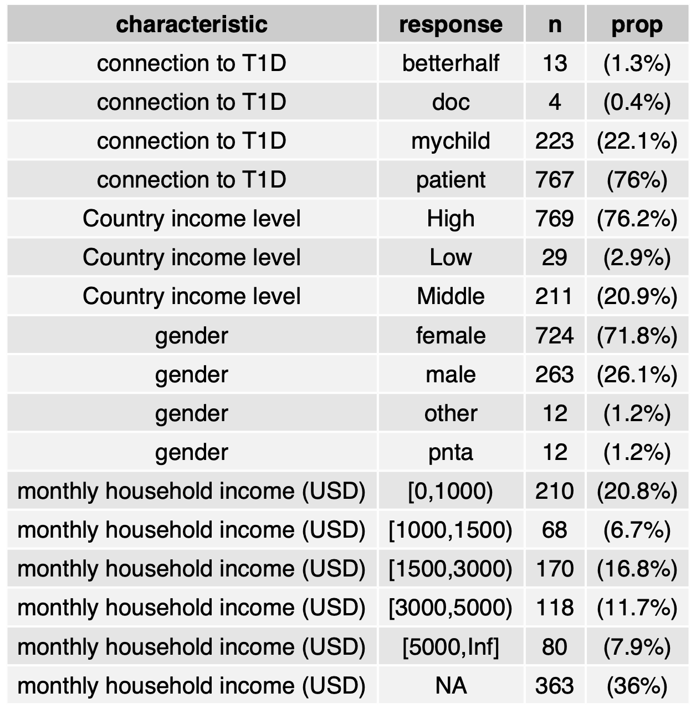
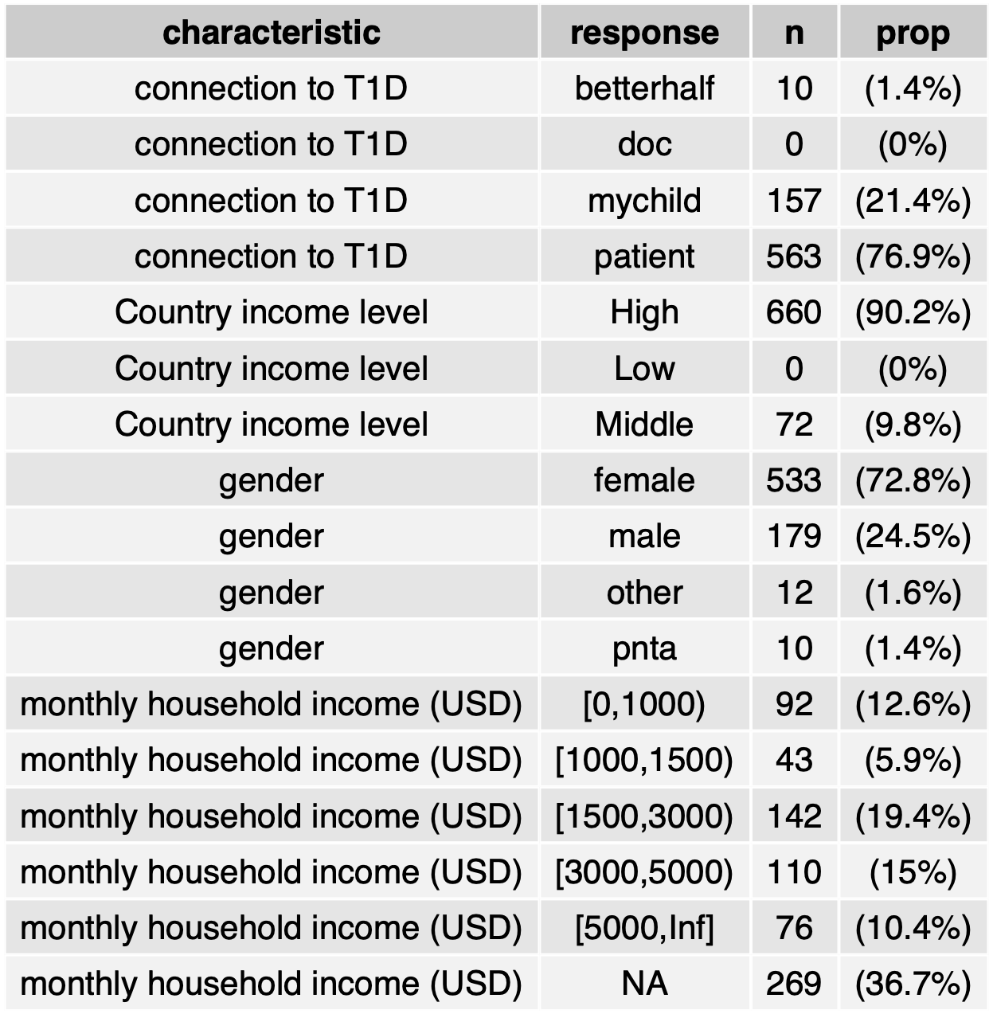
Demographic table
Updated Mar. 2023 ✅
Worldwide (N=1,009)
Top 7 (N=732)

Slide 15
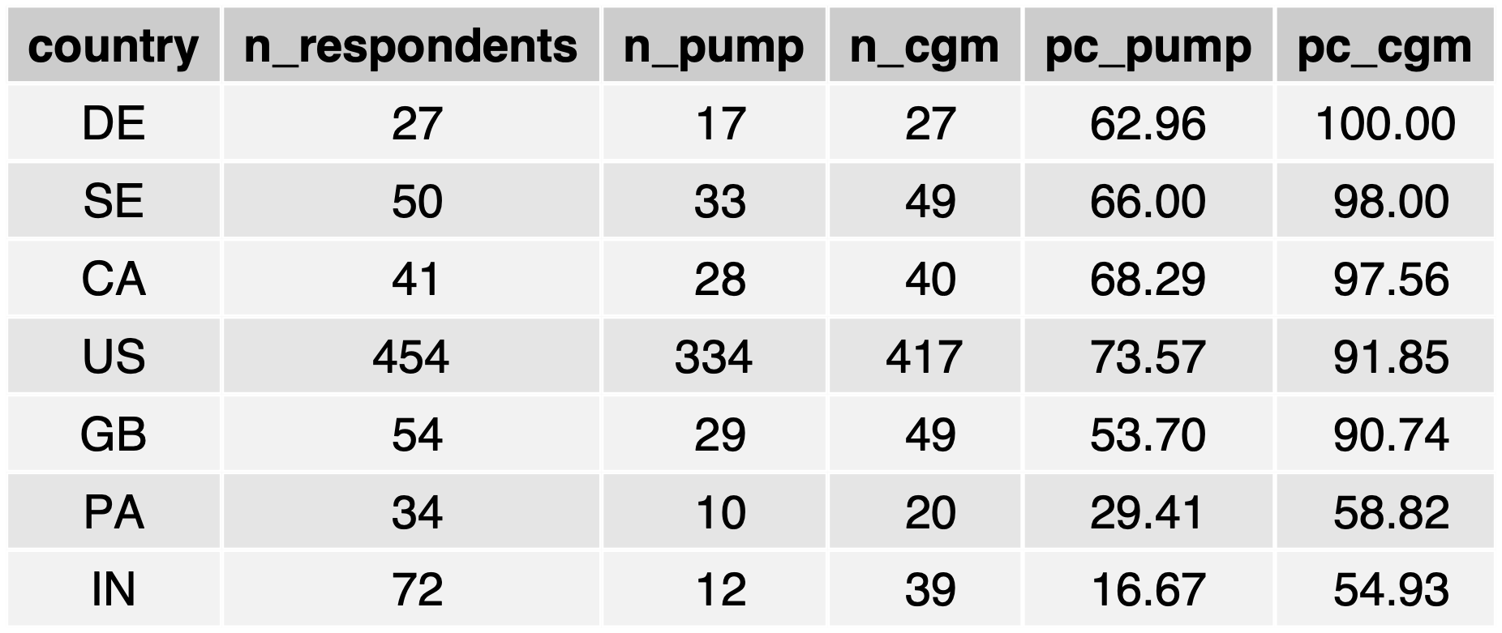
Pump & CGM users
NEW Feb. 2023 ✅
Percentage in top 7 countries
Ordered (top to bottom) from highest to lowest % of users with CGM and then with a pump.
Basically recapitulates grouping of countries (EU).
US with highest percentage of pump usage!
PA & IN are the worst, by far.

